Slide 1
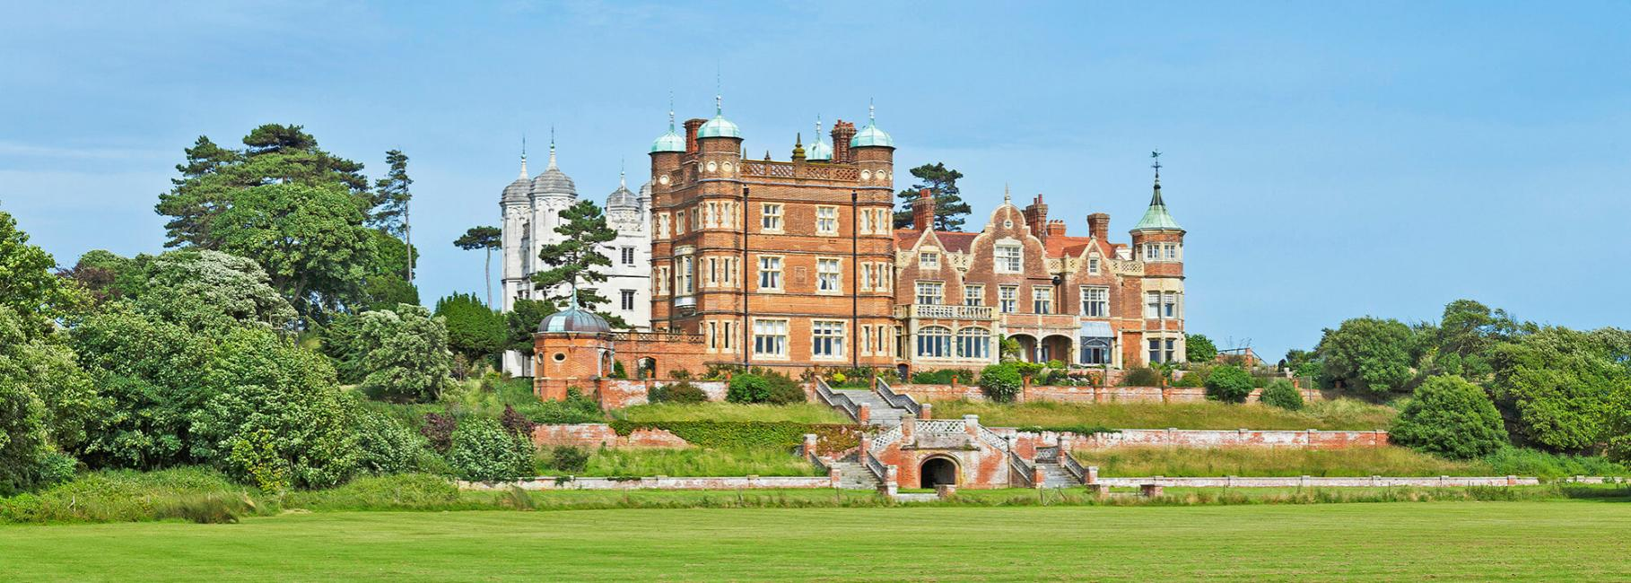
Bawdsey Manor 2023

Slide 2
Key details:
We will be leaving at 8:50 on the Wednesday 21st June so children will need to be at school for 8:15- drop bags in KS2 hall, then register in classroom- first stop is mini golf in Suffolk!
Children will need a packed lunch for the Wednesday- we eat at crazy golf before heading to Bawdsey
We are returning Friday 23rd June- around 3:30 pm
School hoodies given out on the morning when we leave
£5 spending money for the shop
Detailed risk assessment carried put prior to the visit by us and submitted to Essex LA (Evolve)
PGL Bawdesy is registered provider for trips and residentials
https://www.pgl.co.uk/en-gb/school-trips/primary-schools/centres/bawdsey-manor

Slide 3
What are out aims for the trip:
Develop independence
Building positive relationships with others
Developing confidence
Developing resilience
To have fun
Preparing for secondary school life
The Highwoods High Five…
Kind, Respectful, Responsible, Honest and Positive

Slide 4
Medication
Medical forms to be completed and sent back to the teachers
All medication administered by a teacher and then stored safely
Asthma inhalers stay with the children
Travel sickness pills given before we leave on the Wednesday- staff will give the to children before we leave on the Friday

Slide 5
Communication
The school will send daily PINGs to update you so please make sure PING works
We will also update Twitter and the school website with photos so you can see what we get up to.
Children do not bring phones/i-pads- they need a break from technology.
Should there be a birthday or special event, we can set up calls home so you can speak with them.

Slide 6
Dorms and grouping
Children have had the opportunity to request who they would like to be with- we always make sure they have at least one friend with them
Children find out dorms when we get to Bawdsey
Groups for dorms and activities can be different so children mix with each other
We do our best to separate any children who might need space from each other
Children do need to bring their own bedding/sleeping bag, and pillow
Teachers have their own room in the corridor where children stay so there is always close supervision

Slide 7
Food
Children can brings snacks and treats- not too much and all nut free
Breakfast- hot option, fruit and cereals- no coffee or tea.
Lunch- could be hot option, plus sandwiches/jackets etc
Dinner- hot option, dessert, salad options, drinks etc
Dietary request are always catered for- please complete the form that we send home.
Children eat with teachers- we have an allocated time slot and space in the canteen so children can always sit with their friends

Slide 8
Activities
Abseiling
Giant zip line
Sports games
Camp fire and songs
Assault course
Jacobs ladder/climbing
Giant swing
Archery/rifle shooting
https://www.pgl.co.uk/en-gb/school-trips/primary-schools/centres/bawdsey-manor
The PGL website above has lots of photos and extra information

Slide 9
Clothing and essential items
Sleeping bag/bedding and a pillow
Clothes that cover arms and legs- we want to avoid rope burns etc
Towel
Clothes list will be sent home to all parents and is on the website
Water bottle-essential!
https://www.pgl.co.uk/en-gb/school-trips/resources/parent-guide/about
No aerosol deodorant due to sensitive fire alarms!
No need for swimwear

