Slide 1
Bawdsey- 20.05.26-22.05.26

Slide 2
Arrival at school
Suitcases to be loaded onto mini- bus on arrival.
Enter into KS2 hall with backpacks- including packed lunch.
Medicines will be handed over to staff designated (male and female).
Children registered in classrooms. Hoodies given out.
Leave 9:15am.

Slide 3
Medication
All medication will be administered by a teacher and then stored safely
Children must not have any medication in their bag e.g. Calpol - this needs to be given to teachers on the Wednesday.
Asthma inhalers stay with the children throughout the trip
Travel sickness pills given before we leave on the Wednesday- staff will give the to children before we leave on the Friday

Slide 4
Communication
The school will send daily PINGs to update you so please make sure PING works
We will also update Twitter and the school website with photos so you can see what we get up to
Children do not bring phones/i-pads- they need a break from technology
Should there be a birthday or special event, we can set up calls home so you can speak with them
Bawdsey Manor is about an hour away so within close proximity if children needed to return home for an emergency

Slide 5
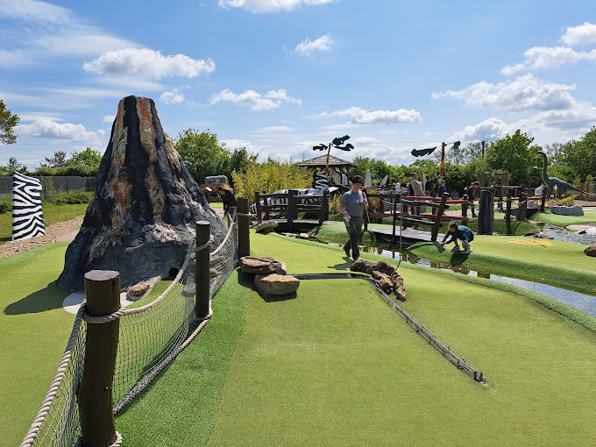
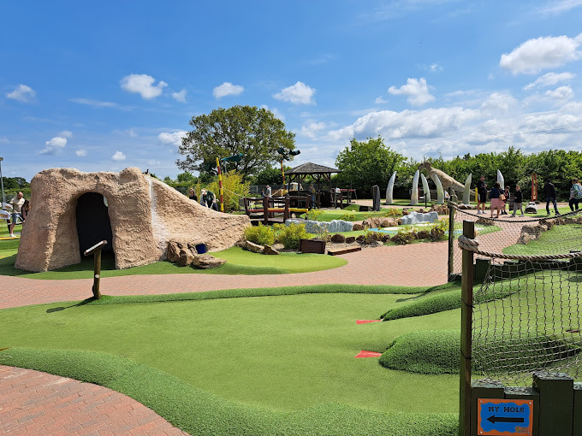
Crazy Golf

Slide 6

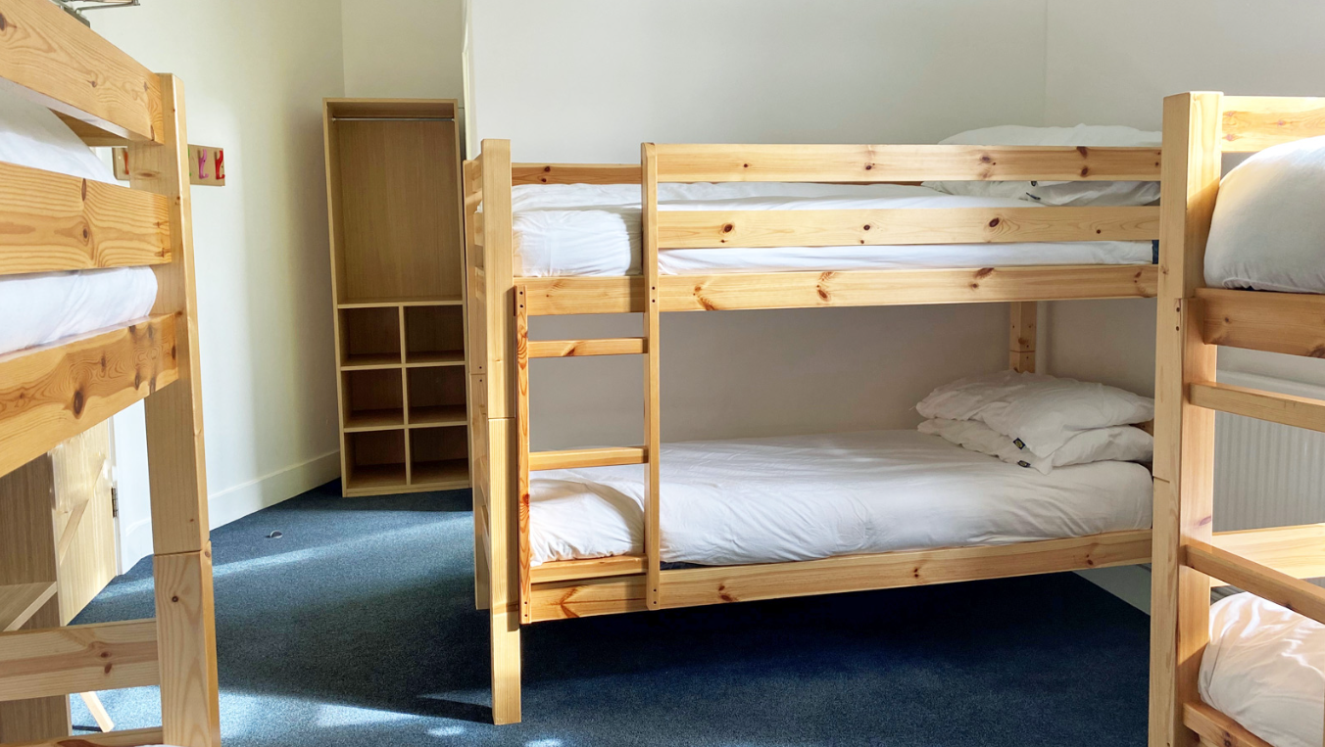
Bawdsey

Slide 7
Dorms and grouping
Children have had the opportunity to request who they would like to be with - we always make sure they have at least one friend with them
Children find out dorms when we get to Bawdsey
Groups for dorms and activities can be different so children mix with each other
We do our best to separate any children who might need space from each other
Children do need to bring their own bedding/sleeping bag and pillow
Teachers have their own room in the corridor where children stay so there is always close supervision

Slide 8
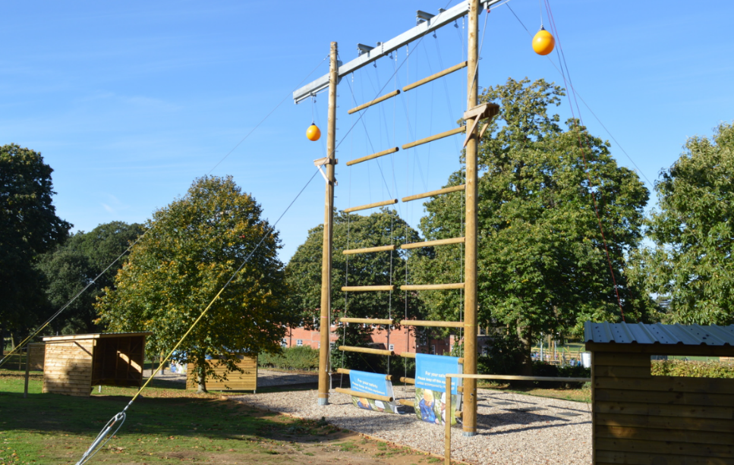
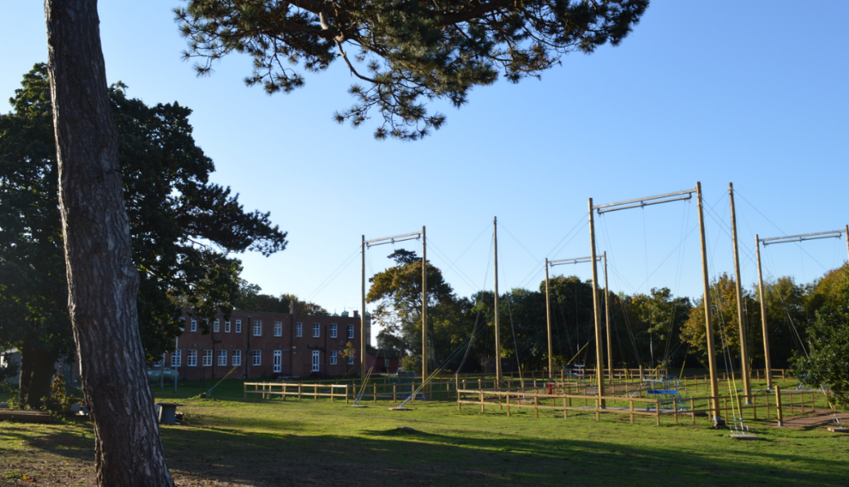
Activities
Climbing
Archery
Raft building/ canoeing- shoes (bin bag)
Giant swing
Jacob’s ladder
Sensory trail
Leap of faith
Coastal walk
Rifle shooting
Abseiling

Slide 9
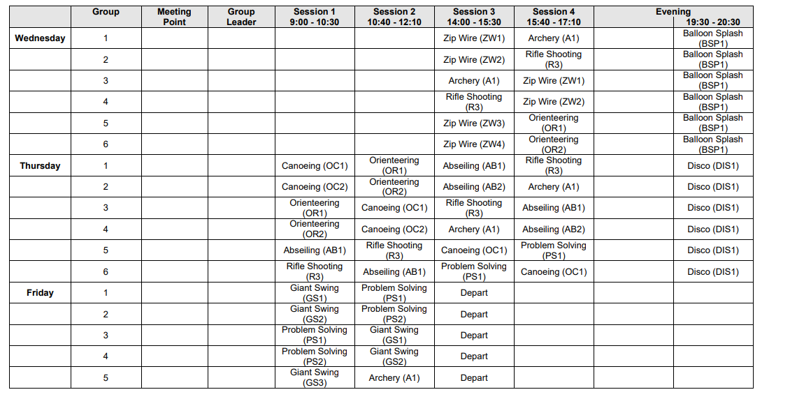
Daily Itinerary

Slide 10
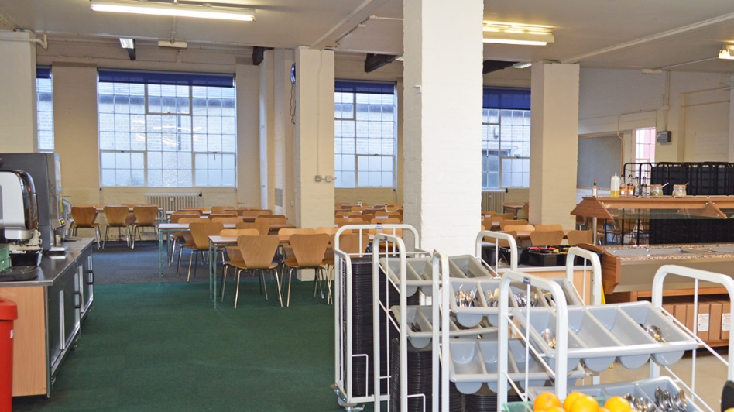
Food
Children can brings snacks and treats - not too much and all nut free
Breakfast- hot option, fruit and cereals - no coffee or tea
Lunch - could be hot option, plus sandwiches/jacket potatoes etc
Dinner - hot option, dessert, salad options, drinks etc
Dietary request are always catered for
Children can eat with teachers, PGL staff or their friends - we have an allocated time slot and space in the canteen so children can always sit with their friends
Last meal- lunch on Friday
Arrival home estimated: 3:00pm

Slide 11
Clothing and essential items
Sleeping bag/bedding and a pillow
Clothes that cover arms and legs - we want to avoid rope burns etc
Towel
Clothes list will be sent home to all parents and is on the website
Named water bottle is essential!
Mosquito spray
Sun cream
No aerosol deodorant due to sensitive fire alarms!
Definitely need ‘old’ trainers that you do not mind getting wet, plus a set of trainers that can be kept dry for all the other events.

Slide 12
Reminders
Appropriate clothing
Maximum £5.00 spending money for shop
Labelled water bottle with school name
No electronics
No phones
Packed lunch to take- disposable

